Slide 1
Lab5 - MaskGIT for Image Inpainting
2024 Summer
詹雨婷

Slide 2
Important Date
 | LAB1 Back-Propagation | LAB2 CNN | LAB3 CNN | LAB4 VAE | LAB5 MaskGIT | LAB6 Generative Models
Announce | 7/9 (Tabc) | 7/16 (Tabc) | 7/23 (Tabc) | 7/30 (Tabc) | 8/6 (Tabc) | 8/13 (Tabc)
DEMO | 7/16 (Tabc) | 7/23 (Tabc) | 7/30 (Tabc) | 8/13 (Tabc) | No demo | No demo

Slide 3
Submission
Score: 50% experiment score + 50% report
If the zip file name or the report spec have format error, you will be punished (-5)
Submission Deadline: 8/23 (Fri) 11:59 a.m.
Turn in: a. Experiment Report (.pdf) b. Source code
Notice : zip all files in one file and name it like「DL_LAB5_YourStudentID_ name.zip」, ex: [DL_LAB5_312581028_詹雨婷.zip」

Slide 4
Introduction

Slide 5
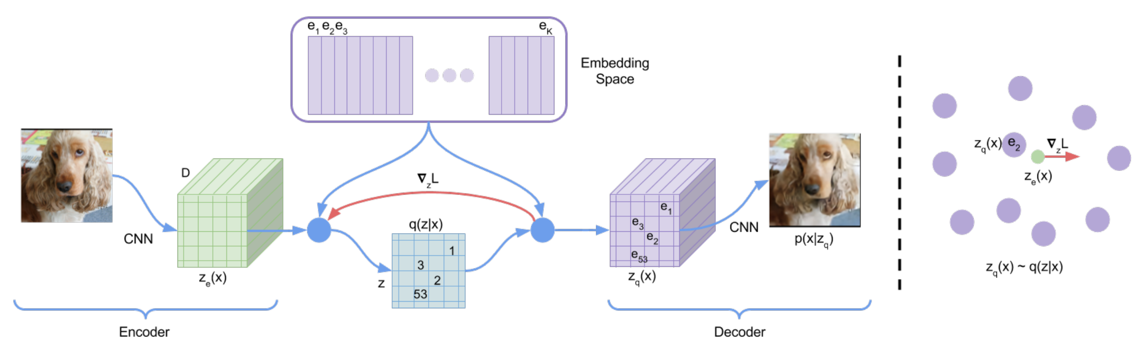
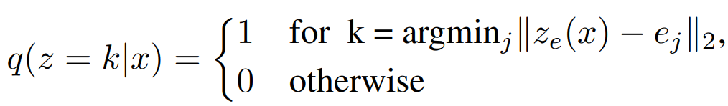
VQ-VAE (prior work)

Slide 6
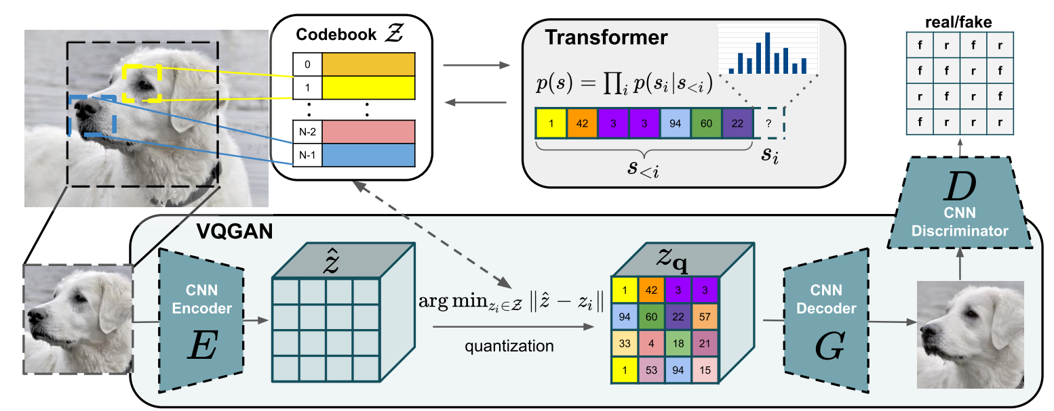
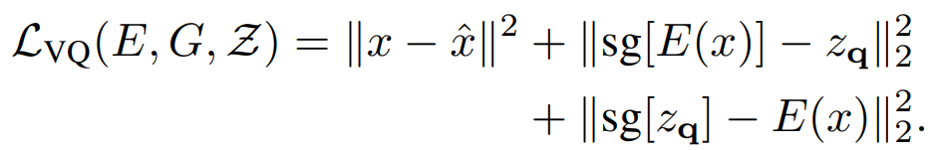
VQ-GAN (prior work)
Perceptual loss replace L2 loss
Transformer (AR model) prior ancestral sampling z

Slide 7
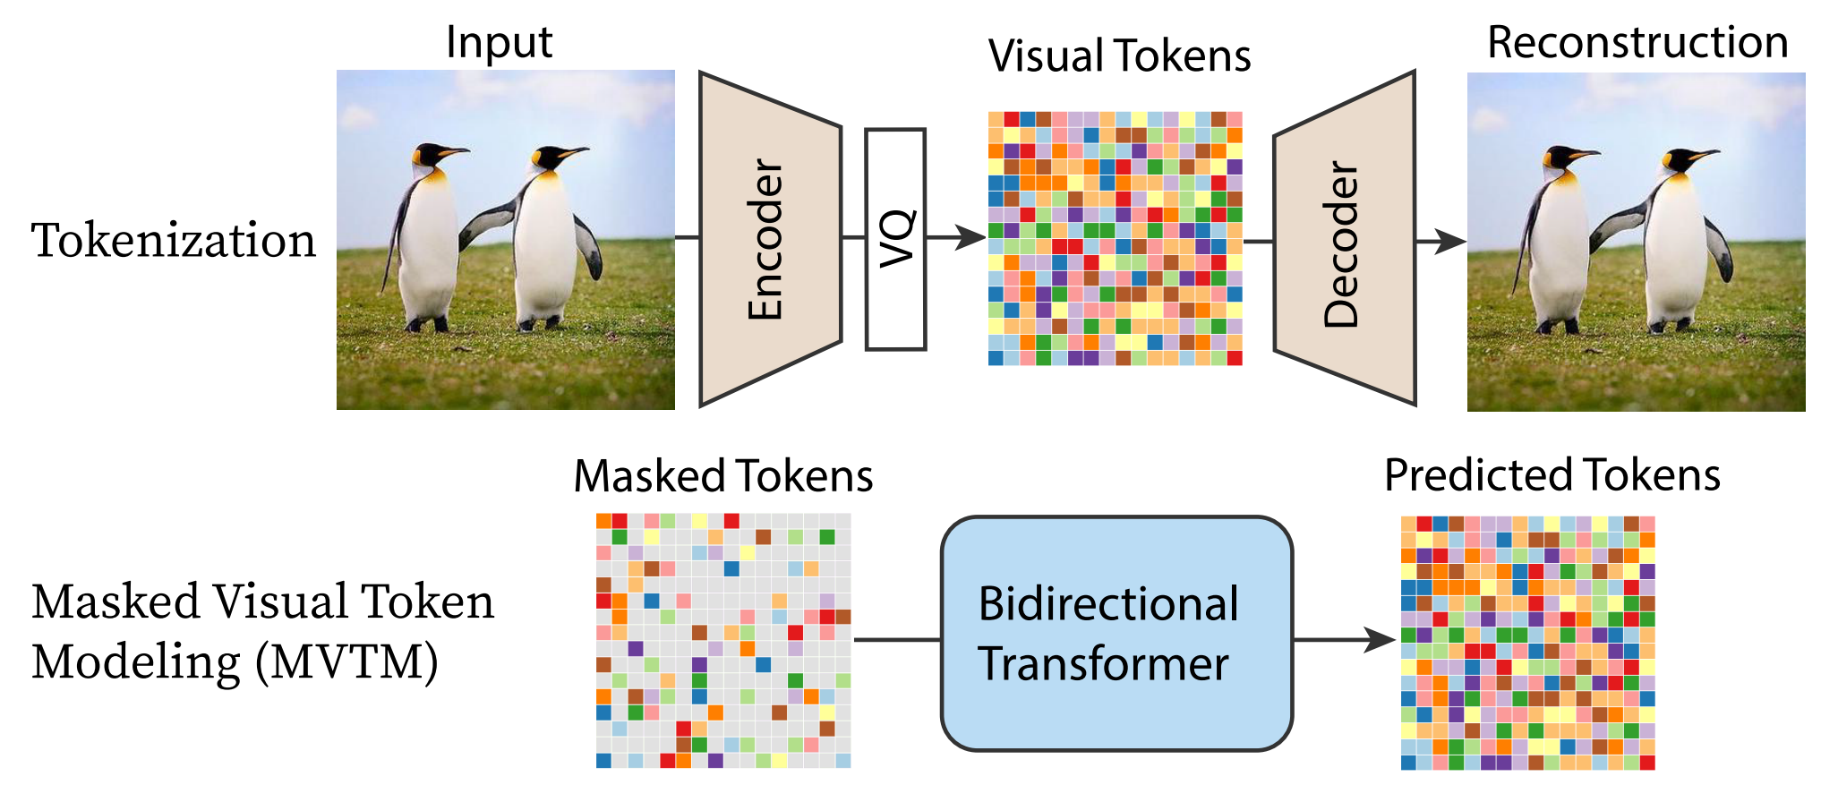
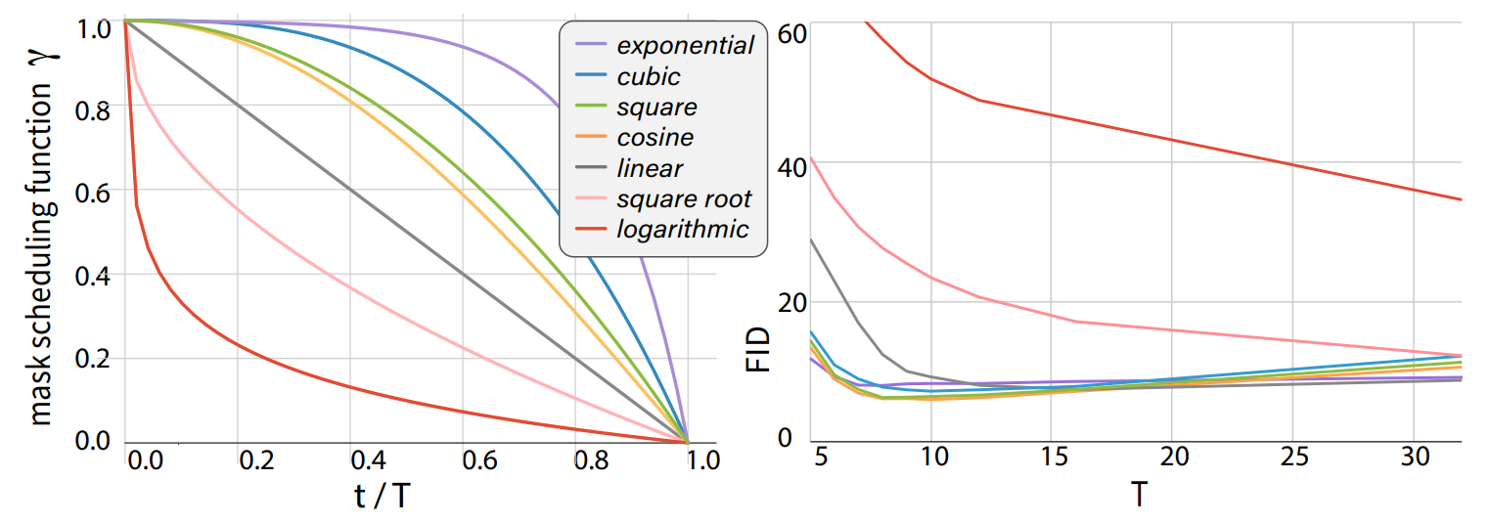
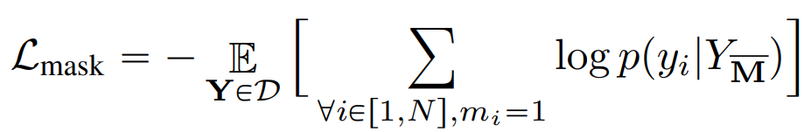
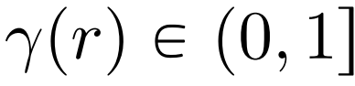
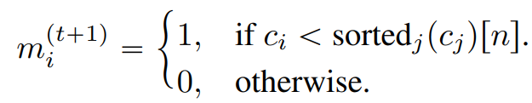

MaskGIT Pipeline Overview
STAGE1
STAGE2
Transformer (BERT) prior ancestral sampling z
MVTM in Training
Iterative Decoding
Notes:
Token embedding 1024+1(mask)->1025,768
Enc consists of multihead attention, mlp
Tokenpredict latent domain ->token domain

Slide 8
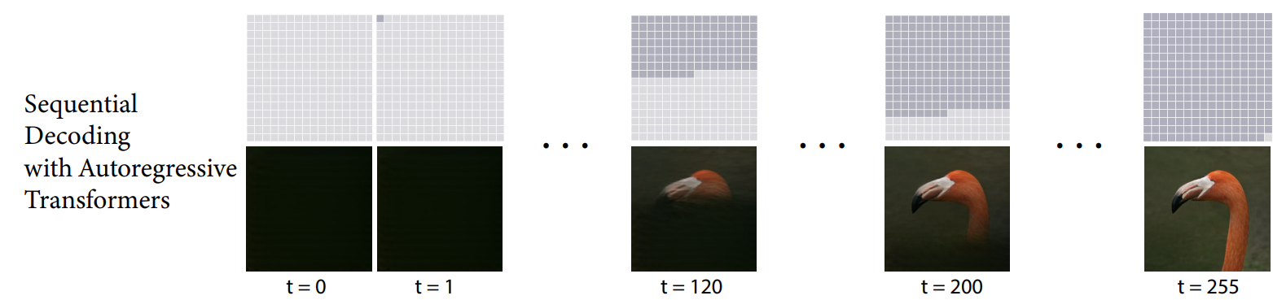
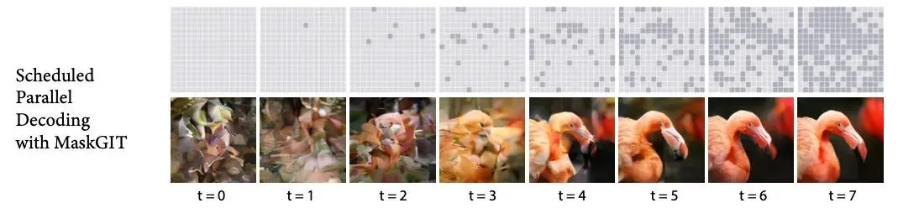
Iterative Decoding
VQGAN
MaskGIT

Slide 9
Lab Details

Slide 10
Lab Objective
Focus on implementing MaskGIT for the inpainting task
During testing, images contain gray regions indicating missing information, which we aim to restore using MaskGIT.
The key practical emphasis of this lab lies in three main areas:
Multi-head attention
Transformer training
Inference inpainting
Notes:
In our lab, we focus on implementing MaskGAN for the inpainting task. During testing, images may contain gray regions indicating missing information, which we aim to restore using MaskGAN. Our primary focus lies in three key areas: multihead attention, transformer training, and inference inpainting. We emphasize developing efficient multihead attention mechanisms to capture complex relationships within the image context. Additionally, we refine transformer training techniques to enhance the model's ability to learn and generalize inpainting tasks effectively. Finally, we prioritize optimizing the inference process for inpainting, ensuring swift and accurate completion of missing regions in test images. Through these efforts, we aim to advance the capabilities of inpainting models for practical image restoration applications.

Slide 11
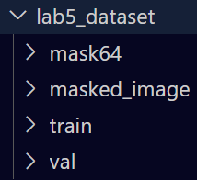
Dataset
a. Training dataset
image: 12000 png files (./lab5_dataset/train)
b. Validation dataset
image: 3000 png files (./lab5_dataset/val)
c. Testing dataset
masked image: 747 png files (./lab5_dataset/masked_image)
mask: 747 png files (./lab5_dataset/mask64 )
Reference: https://www.kaggle.com/datasets/spandan2/cats-faces-64x64-for-generative-models

Slide 12
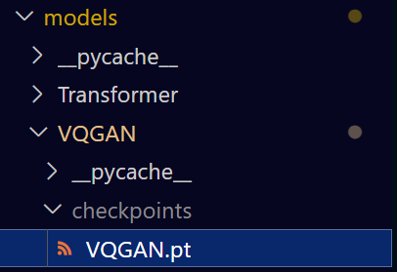
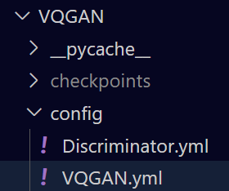
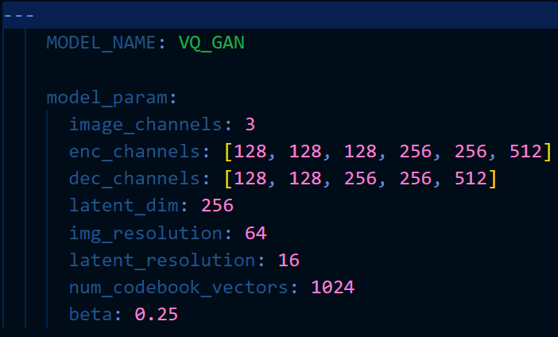
VQGAN Stage1 Pretrained Weight
You can’t modify any model structure or retrain stage1.

Slide 13
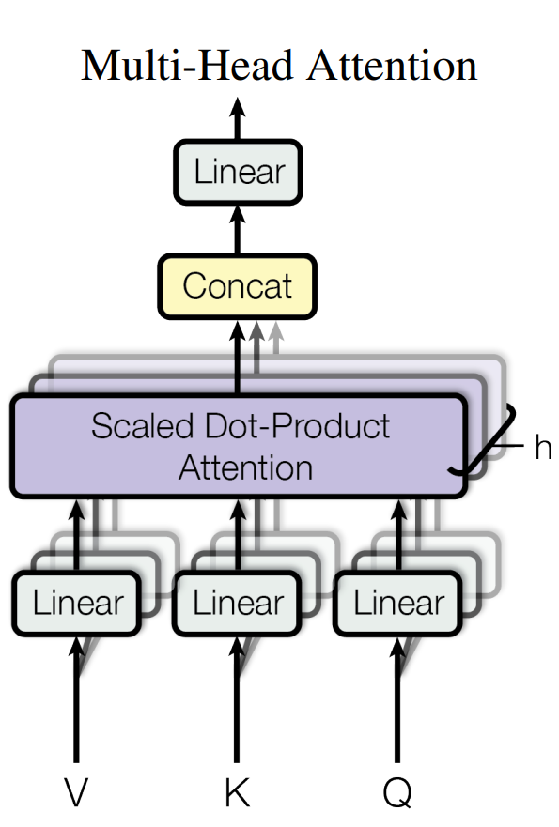
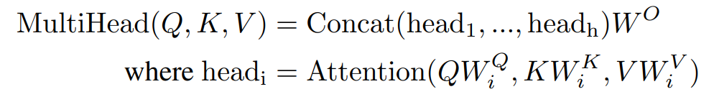
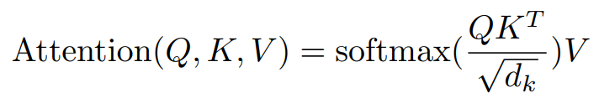
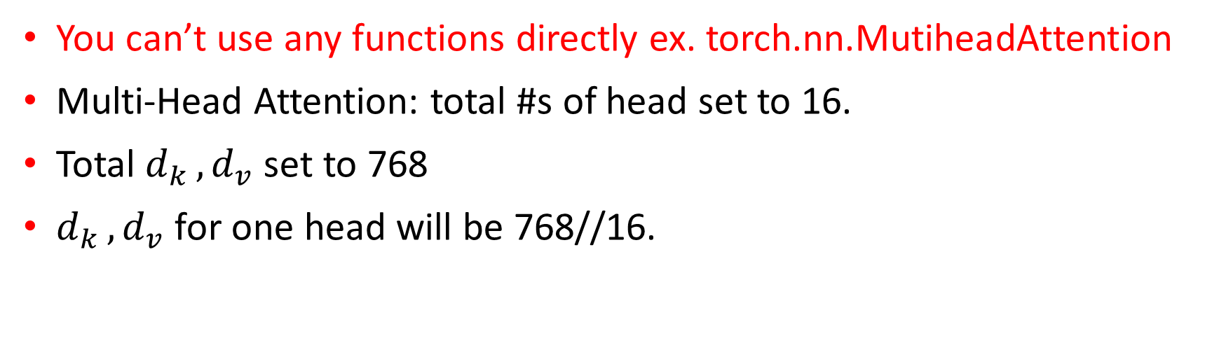
Multi-Head Self-Attention
You can’t use any functions directly ex. torch.nn.MutiheadAttention
Multi-Head Attention: total #s of head set to 16.
Total $d_{k }, d_{v}$ set to 768
$d_{k }, d_{v}$ for one head will be 768//16.

Slide 14

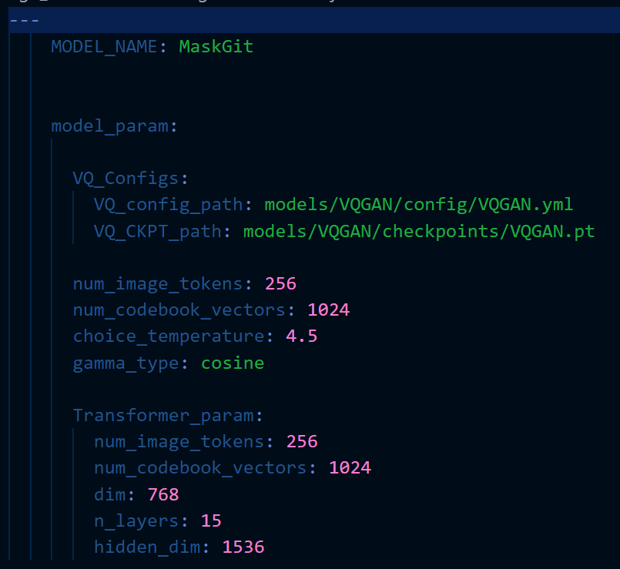
MaskGIT Stage2 Training
You can’t modify any model structure.
Multi-Head Attention: total #s of head set to 16.

Slide 15
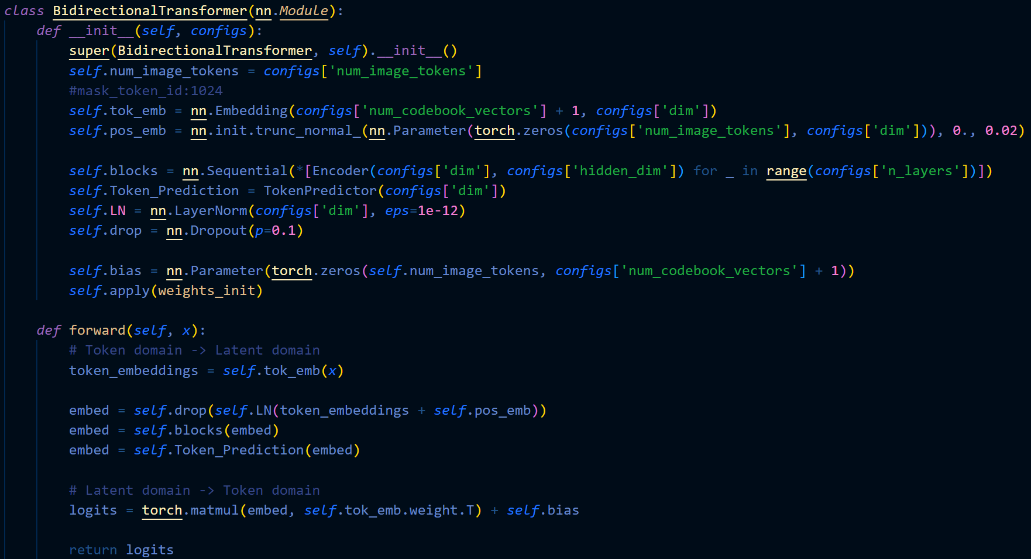
How to set the Masked token?

Slide 16
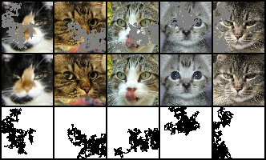
Inference for Image Inpainting Task
Tokenize the masked image
Interpret the inpainting mask as the initial mask in iterative decoding
Notes:
We extend MaskGIT to this problem by tokenizing the masked image and interpreting the inpainting mask as the initial mask in our iterative decoding. We then composite the output image by linearly blending it with the input based on the masking boundary following [8]. To match the training of our baselines, we train MaskGIT on the 512ˆ512 center-cropped images from the Places2 [58] dataset. All hyperparameters are kept the same as the MaskGIT model trained on ImageNet

Slide 17
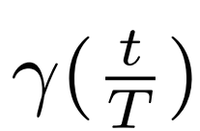
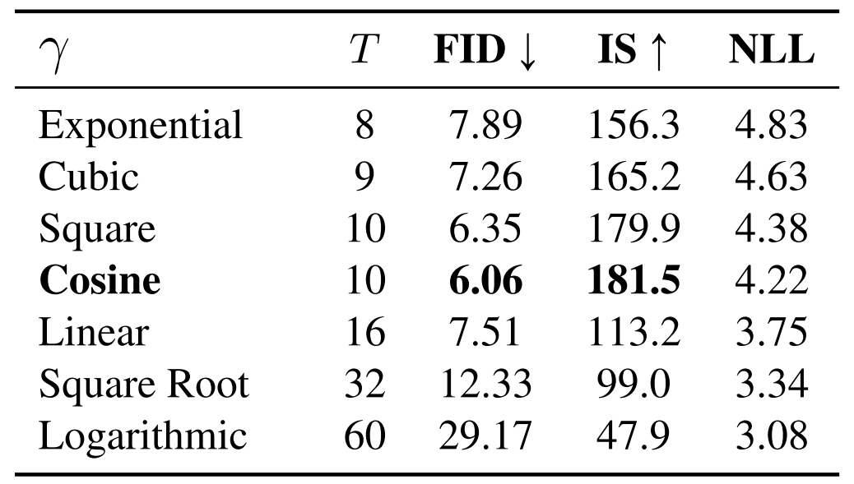
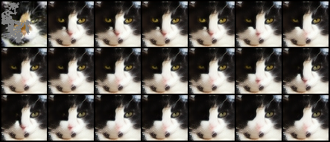
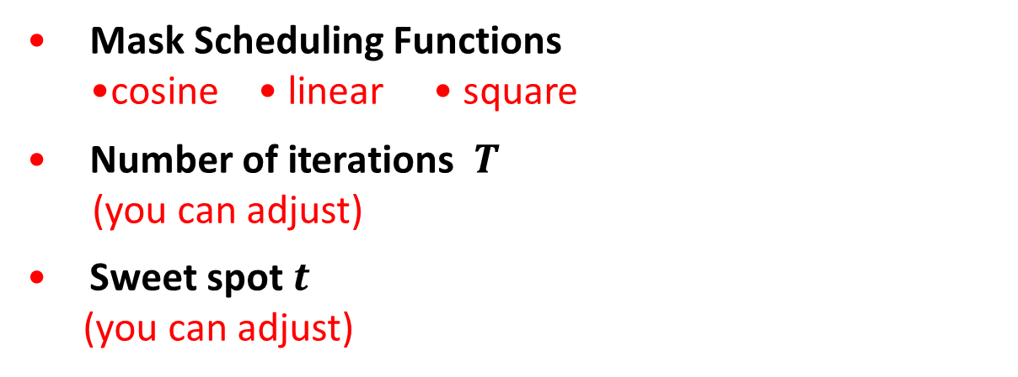
Iterative Decoding
Mask Scheduling Functions •cosine • linear • square
Number of iterations $T$
(you can adjust)
Sweet spot $t$
(you can adjust)

Slide 18
Requirements
Download the dataset and pretrained weight of VQGAN (MaksGIT stage1).
Implement the Multi-head attention module on your own, if you use any function directly, your score will -15.
Train your transformer model (MaskGIT stage2) from scratch.
Implement iterative decoding for inpainting task.
Compare the FID score with different settings of mask scheduling parameters and visualize the iterative decoding for mask in latent domain or predicted images.
Notes:
dataset download: https://drive.google.com/file/d/1FTVXBmzyWqtRYWPskNUH3_Lq0vnsC_xO/view?usp=sharing
VQGAN pretrained weight: https://drive.google.com/file/d/1twIeYTRAJcRFU2AZrAQ78PkfA6klwqn5/view?usp=sharing

Slide 19
Report Spec (50%)
1. Introduction (5%)
2. Implementation Details (45%)
A. The details of your model (Multi-Head Self-Attention)
(if you directly call any function, you can’t get any score in this part.)
B. The details of your stage2 training (MVTM, forward, loss)
C. The details of your inference for inpainting task (iterative decoding)
3. Discussion(bonus: 10%)
A. Anything you want to share

Slide 20

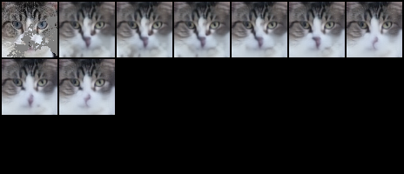
Experiment Score (50%)
(Prove your code implementation is correct)
show iterative decoding
Experimental results (30%)
•cosine • linear • square
1.Mask in latent domain
2.Predicted image

Slide 21
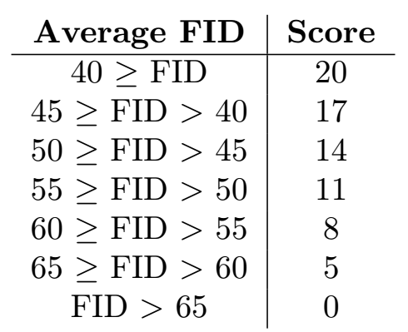
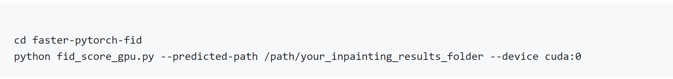
Experiment Score (50%)
The Best FID Score(20%)
• Screenshot
• Masked Images v.s MaskGIT Inpainting Results v.s Ground Truth
• The setting about training strategy, mask scheduling parameters, and so on

Slide 22
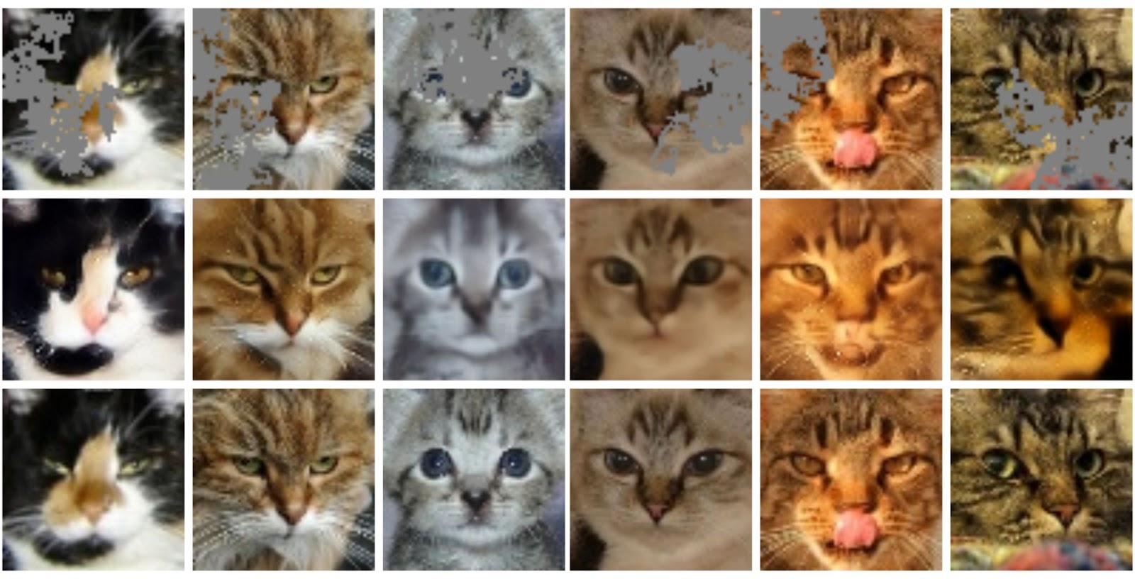
Masked
Images
MaskGIT Inpainting
Results
Ground
Truth

Slide 23
References
Ashish Vaswani, Noam Shazeer, Niki Parmar, Jakob Uszkoreit, Llion Jones, Aidan N. Gomez, Lukasz Kaiser, and Illia Polosukhin. Attention is all you need. In NeurIPS, 2017. https://arxiv.org/pdf/2202.04200.pdf
A. van den Oord, O. Vinyals, et al., “Neural discrete representation learning,” in Advances in Neural Information Processing Systems, pp. 6306–6315, 2017. https://arxiv.org/abs/1711.00937
Esser, P., Rombach, R., and Ommer, B.: Taming Transformers for High-Resolution Image Synthesis. In: Proceedings of the IEEE/CVF Conference on Computer Vision and Pattern Recognition, pp. 12873–12883 (2021) https://arxiv.org/abs/2012.09841
Huiwen Chang, Han Zhang, Lu Jiang, Ce Liu, and William T. Freeman. Maskgit: Masked generative image transformer. In: Proceedings of the IEEE/CVF Conference on Computer Vision and Pattern Recognition, June 2022. https://arxiv.org/abs/2202.04200

